Slide 1
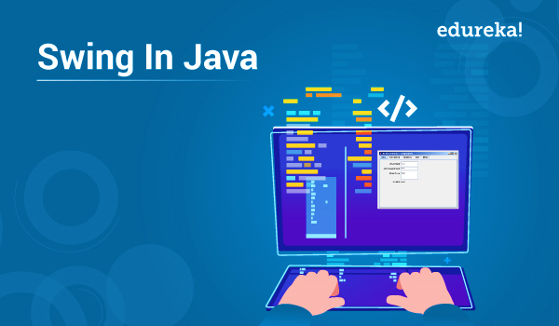
What is Swing?
Swing API is a set of extendable GUI parts to ease the developer’s life to form JAVA primarily based Front End/GUI Applications.
It turns on prime of AWT API and acts as a replacement of AWT API since it’s nearly every management comparable to AWT controls. Swing part follows a Model-View-Controller design to meet the subsequent criteria.

Slide 2
Swing Feature
A single API is to be adequate to support multiple look and feel.
API is to be model driven in order that the best level API isn’t needed to own information.
API is to use the Java Bean model in order that Builder Tools and IDE will give higher services to the developers to be used.

Slide 3

What is JavaFX?
JavaFX may be a GUI toolkit for Java (GUI is brief for Graphical User Interface). JavaFX makes it easier to form desktop applications and games in Java. JavaFX has replaced Swing because of the suggested GUI toolkit for Java. What is more, JavaFX is additional consistent in its style than Swing and has additional options. It’s additional fashionable too, sanctioning you to style GUI victimization layout files (XML) and elegance them with CSS, similar to we tend to are accustomed to network applications.

Slide 4
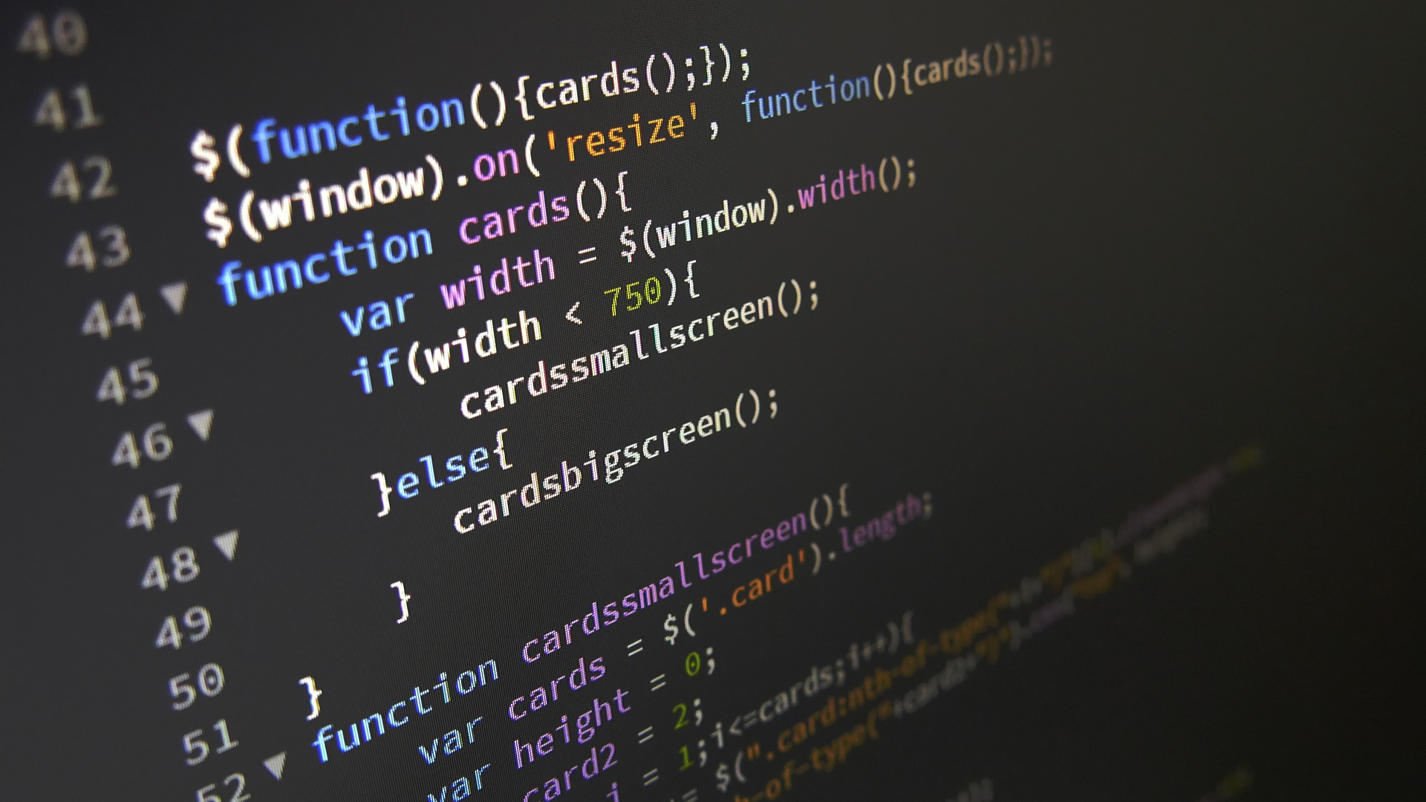
JavaFX Feature
JavaFX comes with an oversized set of intrinsic GUI parts, like buttons, text fields, tables, trees, menus, charts and far additional. That saves you tons of your time once building a desktop application.
JavaFX parts are often styled using CSS, and you’ll be able to use FXML to compose a GUI rather than doing it in Java code. This makes it easier to quickly place a GUI along, or amendment the appearance or composition while not having to play within the Java code.

Slide 5
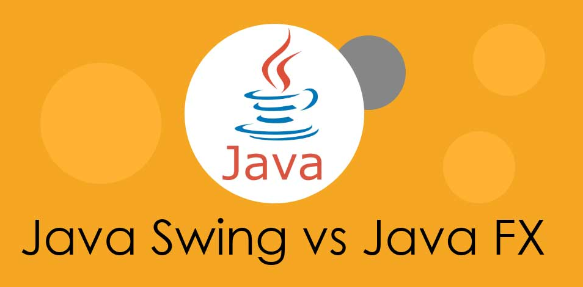
Why we choose JavaFX instead of Swing?

Slide 6
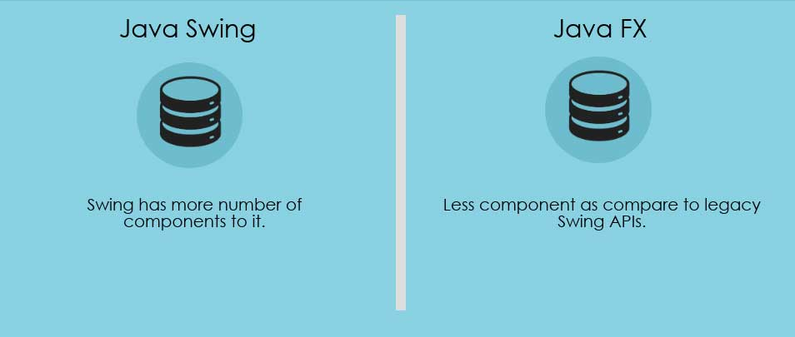

Slide 7
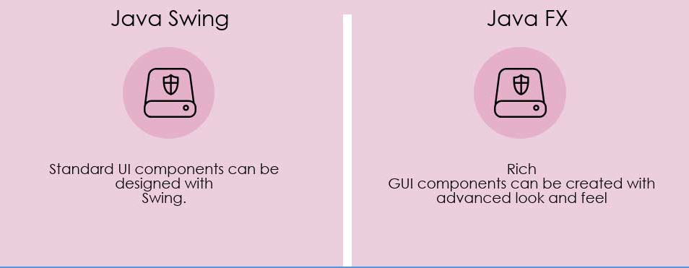

Slide 8
